Slide 1
Analyze Your Service Desk Ticket Data
Take a data-driven approach to service desk optimization.
EXECUTIVE BRIEF

Slide 2


Analyst Perspective
The perfect time to start analyzing your ticket data is now
Service desks improve their services by leveraging ticket data to inform their actions. However, many organizations don’t know where to start. It’s tempting to wait for perfect data, but there’s a lot of value in analyzing your ticket data as it exists today.
Start small. Track key tension metrics based on the out-of-the-box functionality in your tool. Review the metrics regularly to stay on track.
By reviewing your ticket data, you’re going to get better organically. You’re going to learn about the state of your environment, the health of your processes, and the quality of your services. Regularly analyze your data to drive improvements.
Make ticket analysis a weekly habit. Every week, you should be evaluating how the past week went. Every month, you should be looking for patterns and trends.
Benedict Chang
Research Analyst, Infrastructure & Operations
Info-Tech Research Group
Ken Weston ITIL MP, PMP, Cert.APM, SMC
Research Director, Infrastructure & Operations
Info-Tech Research Group

Slide 3



Executive Summary
Your Situation
Common Obstacles
Info-Tech’s Approach
Leverage your service desk ticket data to gain insights for improving your operations:
Use a data-based approach to allocate service desk resources.
Design appropriate SLOs and SLAs to better service end users.
Gain efficiencies for your shift-left strategy.
Communicate the current and future value of the service desk to the business.
Properly analyzing ticket data is challenging for the following reasons:
Poor ticket hygiene and unclear ticket handling guidelines can lead to untrustworthy results.
Undocumented tickets from various intake channels prevents you from seeing the whole picture.
Service desk personnel are not sure where to start with analysis and are too busy to find time.
Too many metrics are tracked to parse actionable insights from the noise.
Info-Tech’s approach to improvement:
To reduce the noise, standardize your ticket data in a format that will ease analysis.
Start with common analyses using the cleaned data set.
Identify action items based on your ticket data.
Analyze your ticket data to help continually improve your service desk.
Slow down. Give yourself time.
Give yourself time to observe the new metrics and draw enough insights to make recommendations for improvement. Then, execute on those recommendations. Slow and steady improvement of the service desk only adds business value and will have a positive impact on customer satisfaction.

Slide 4
Your challenge
36% of organizations are prioritizing ticket handling in IT for 2021
This research is designed to help service desk managers analyze their ticket data
  36%
Analyzing ticket data involves:
Collecting ticket data and keeping it clean. Based on the metrics you’re analyzing, define ticket expectations and keep the data up to date.
Showing the value of the service desk. SLAs are meaningless if they are not met consistently. The prerequisite to implementing proper SLAs is fully understanding the workload of the service desk.
Understanding – and improving – the user experience. You cannot improve the user experience without meaningful metrics that allow you to understand the user experience. Different user groups will have different needs and different expectations of the level of service. Your metrics should reflect those needs and expectations.
Source: SDI, 2021
12% of organizations are focusing directly on service desk improvement
  12%
Source: SDI, 2021

Slide 5
Common obstacles
Many organizations face these barriers to analyzing their ticket data:
What your peers are saying about why they can’t start analyzing their ticket data:
“My ITSM doesn’t have the capabilities I need to make informed decisions on shifting tickets left.”
“”My tickets are always missing data”
Finding time to properly analyze ticket data is a challenge. Not knowing where to start can lead to not analyzing the proper data. Service desks end up either tracking too much data or not tracking the proper metrics.
Data, even if clean, can be housed in various tools and databases. It’s difficult to aggregate data if the data is stored throughout various tools. Comparisons may also be difficult if the data sets aren’t consistent.
Shifting left to move tickets toward self-service is difficult when there is no visibility into which tickets should be shifted left.
“I’m constantly firefighting. I have no time for ticket data analysis.”
“My technicians do not consistently update and close tickets.”
ITSM
“I have no idea where to start with the amount of data I have.”
Source: Info-Tech survey, 2021; N=20.

Slide 6

Common obstacles that prevent effective ticket analysis
We asked IT service desk managers and teams about their biggest hurdles
Missing or Inaccurate Information
No Time
No time to figure out the tool or analyze the data properly
Lack of information in the ticket
Categories are too general/specific to draw insights
Poor ticket hygiene
Ineffective Categorization Schemes
Missing Updates
Reduces the power of ticket data
Tickets aren’t updated while being resolved
Tool Limitations
Can’t be easily customized
Too customized to be effective
Desired dashboards unavailable
Correlating Tickets to Identify Trends
Not sure where to start with all the data at hand
Source: Info-Tech survey, 2021; N=20

Slide 7
Info-Tech’s approach
Repeat this analysis every business cycle:
Gather Your
Data
Action the
Results
Communicate the Results
Collect your ticket data OR start measuring the right metrics.
Implement low-effort improvements and celebrate quick successes.
Use your data to show the value of your effort.
Extract & Analyze
Implement Larger Changes
Organize and visualize your data to extract insights
Reference your ticket data while implementing process, tooling, and other changes.

Slide 8
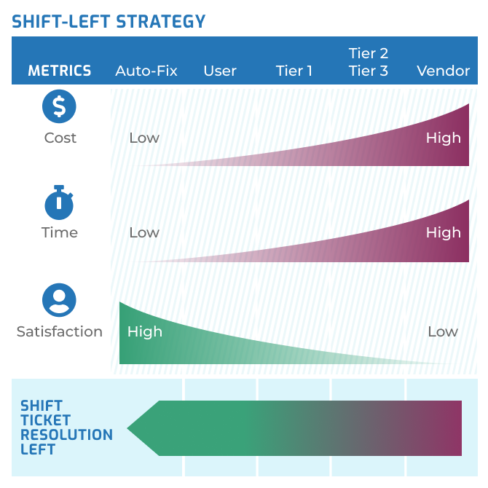

Measure the value of this blueprint
Track these metrics as you improve
Use the data to tell you which aspects of IT need to be shifted left and which need to be automated
Your data will show you where you can improve.
As you act on your data, you should see:
Lower costs per ticket
Decreased average time to resolve
Increased end-user satisfaction
Fewer tickets escalated beyond Tier 1
See Info-Tech’s blueprint Optimize the Service Desk With a Shift-Left Strategy.

Slide 9
Info-Tech’s methodology for analyzing service desk tickets
 | 1. Import Your Ticket Data | 2. Analyze Your Ticket Data | 3. Communicate Your Insights
Phase Steps | Import Your Ticket Data | Analyze High-Level Ticket Data Analyze Incidents, Service Requests, and Ticket Categories | Build Recommendations Action and Communicate Your Ticket Data
Phase Outcomes | Enter your data into our tool. Compare your own ITSM ticket fields to improve ticket data moving forward. | Use the Service Desk Ticket Analysis Tool as a guide to build your own operational dashboards to measure metrics over time. Gain actionable insights from your data. | Use the data to communicate your findings to the business and leadership using the Ticket Analysis Report.

Slide 10
Insight summary
Slow down. Give yourself time. Give yourself time to observe the new metrics and draw enough insights to make recommendations for improvement. Then, execute on those recommendations. Slow and steady improvement of the service desk only adds business value and will have a positive impact on customer satisfaction.
Iterate on what to track rather than trying to get it right the first time.
Tracking the right data in your ticket can be challenging if you don’t know what you’re looking for. Start with standardized fields and iterate on your data analysis to figure out your gaps and needs.
If you don’t know where to go, ticket data can point you in the right direction.
If you have service desk challenges, you will need to allocate time to process improvement. However, prioritizing your initiatives is easier if you have the ticket data to point you in the right direction.
Start with data from one business cycle.
Service desks don’t need three years’ worth of data. Focus on gathering data for one business cycle (e.g. three months). That will give you enough information to start generating value.
Let the data do the talking.
Leverage the data to drive organizational and process change in your organization by tracking meaningful metrics. Choose those metrics using business-aligned goals.
Paint the whole picture.
Single metrics in isolation, even if measured over time, may not tell the whole story. Make sure you design tension metrics where necessary to get a holistic view of your service desk.

Slide 11


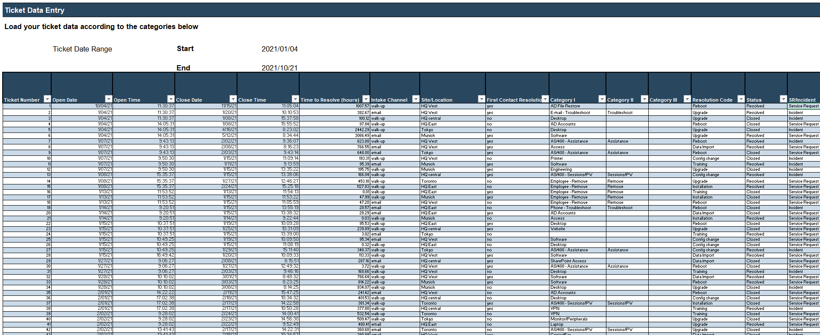
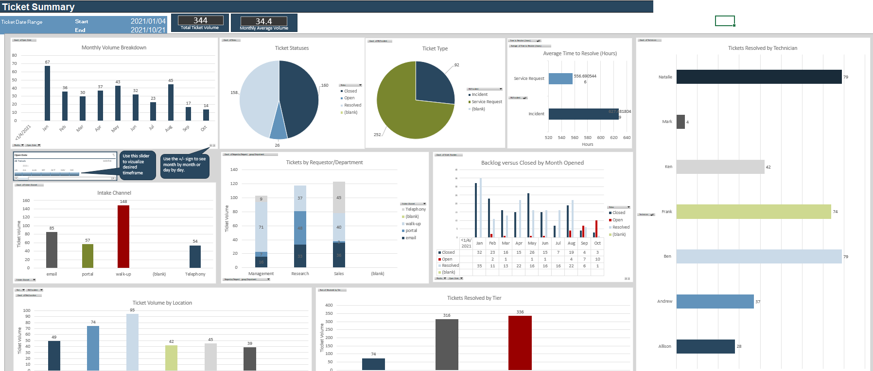
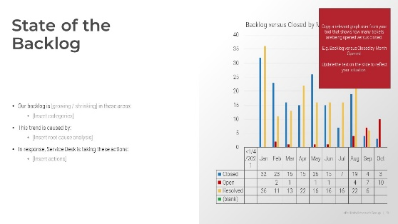
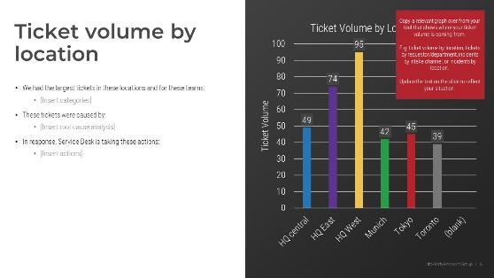
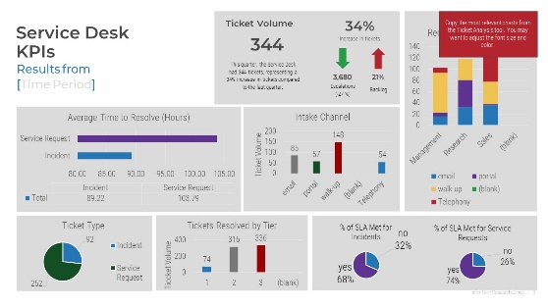
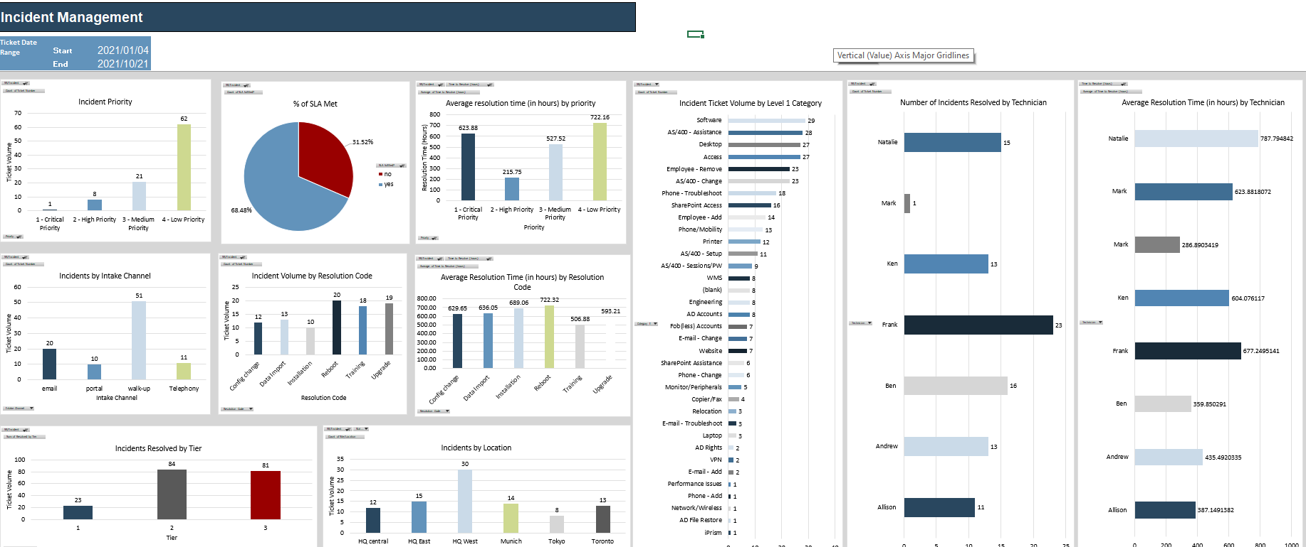
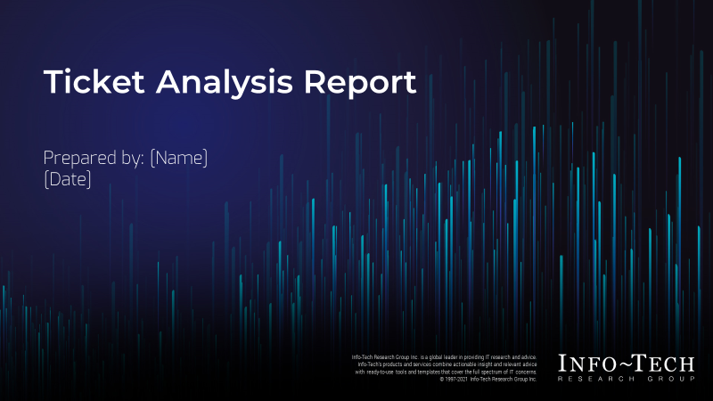
Blueprint deliverables
This blueprint’s key deliverable is a ticket analysis tool. Many of the activities throughout this blueprint will direct you to complete and interpret this tool.
The other main deliverable is a stakeholder presentation template to help you document the outcomes of the project.
  Service Desk Ticket Analysis Tool
  Ticket Analysis Report
Use this tool to identify trends and patterns in your ticket data to action improvement initiatives.
Use this template to document the justification for addressing service desk improvement, the results of your analysis, and your next steps.

Slide 12
Blueprint benefits
IT Benefits | Business Benefits
Discover and implement the proper metrics to improve your service desk Use a data-based approach to improve your customer service and operational goals Increase visibility with the business and other IT departments using a structured presentation | Quicker resolutions to incidents and service requests Better expectations for the service desk and IT Better visibility into the current state, challenges, and goals of the service desk More effective support when contacting the service desk

Slide 14

Guided Implementation
A Guided Implementation (GI) is a series
of calls with an Info-Tech analyst to help implement our best practices in your organization.
A typical GI is 3-4 calls over the course of 2-3 months.
What does a typical GI on this topic look like?
Phase 1
Phase 2
Phase 3
Call #1: Scope requirements, objectives, and your specific challenges. Enter your data into the tool.
Call #2: Assess the current state across the different dashboards.
Call #3: Identify improvements and insights to include in the communication report.
Call #4: Review the service desk ticket analysis report.
Info-Tech Research Group | 14

